Slide 1

Creating and Utilizing Linked Open Statistical Data for the Development of Advanced Analytics Services E. Kalampokis, A. Karamanou, A. Nikolov, P. Haase, R. Cyganiak, B. Roberts, P. Hermans, E. Tambouris, K. Tarabanis

Slide 2
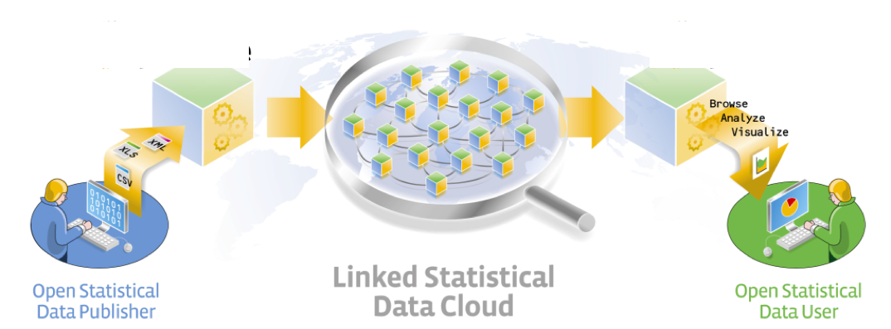
Objective
A major part of Open Data concerns statistics that can be formulated as data cubes.
The objective of this paper is to present the OpenCube approach for working with linked data cubes.
The ultimate goal of OpenCube is to facilitate
Publishing of high-quality linked statistical data
Reusing linked statistical datasets in visualizations and analytics

Slide 3
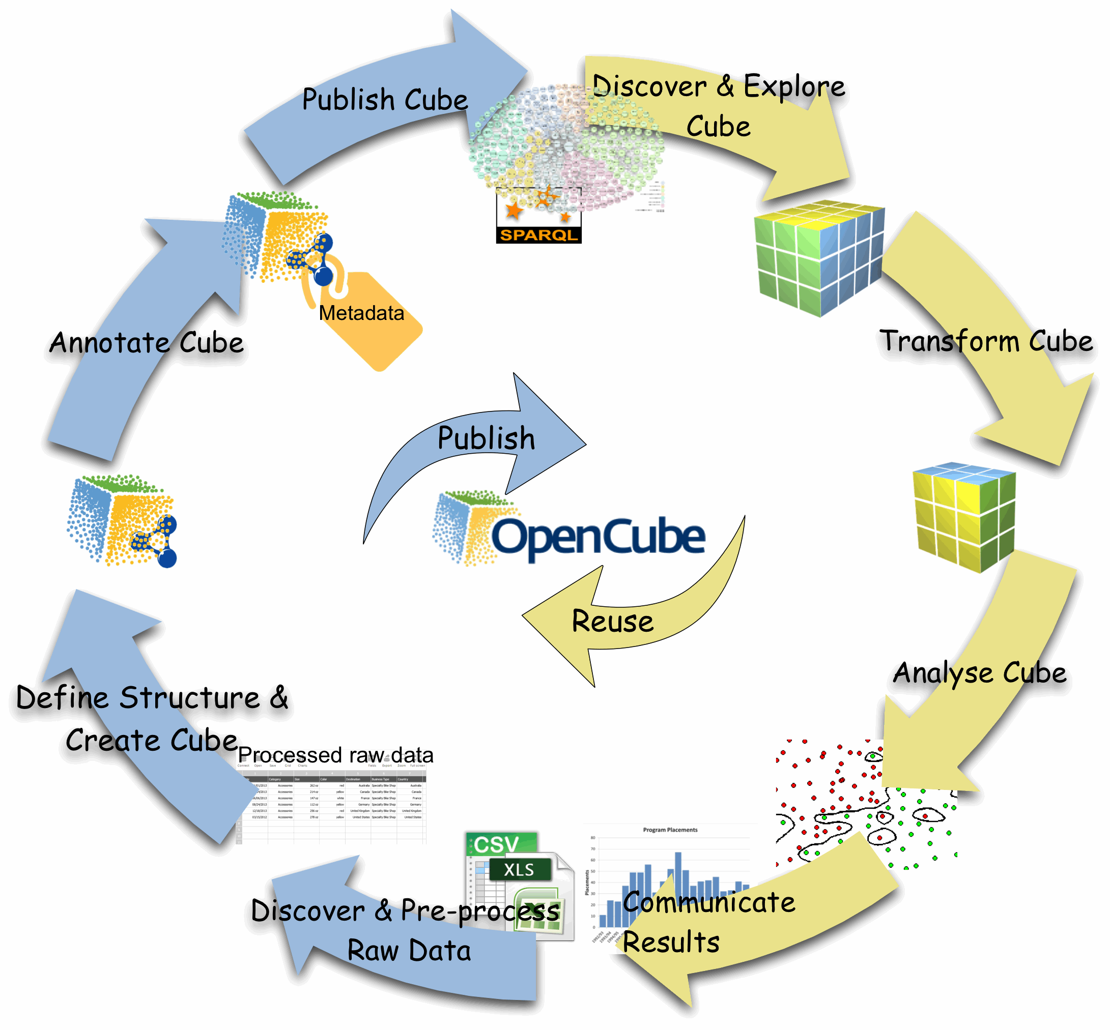
Linked Statistical Data Lifecycle
OpenCube develops components to support the whole lifecycle of linked statistical data.
The lifecycle describes steps that raw data cubes should go through in order to create value.

Slide 4
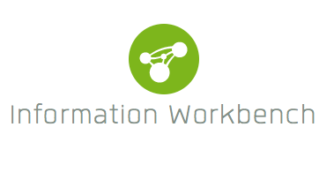

Implementation
Different steps of the lifecycle are realized by separate components.
Two different implementation approaches are considered based on the underlying platform.
fluidOps’ Information Workbench
Swirrl’s PublishMyData
Extensions for the commercial platforms and an Open-Source toolkit.

Slide 5
Components
Publishing components
TARQL extension
D2RQ /R2RML-QB extension
JSON-stat
Grafter
Consuming components
Data catalogue
OpenCube Browser
OpenCube MapView
R Analysis Chart
Aggregation component

Slide 6
TARQL OpenCube Extension
TARQL is a command-line tool for converting CSV files to RDF using SPARQL 1.1 syntax
https://github.com/cygri/tarql
TARQL is a SPARQL based data mapping language.
The OpenCube TARQL extension enables RDF data cubes construction from CSV files.
Redesigned TARQL API
Added streaming evaluation mode
It will be integrated to the IWB platform very soon.

Slide 7
D2RQ/R2RML-QB Extension
The D2RQ OpenCube component enables the generation of RDF data cubes from relational tables.
It builds upon the D2RQ open source platform and it leverages R2RML language.
The component will be integrated into the IWB platform and it will provide an easy to use interface to adjust output mapping.

Slide 8
JSON-stat
The JSON-stat format is a simple lightweight JSON format for multidimensional data.
http://json-stat.org/format/
A JSON-stat file can contain one or more datasets.
Multiple datasets responses allow a provider to disseminate information with few common dimensions in a single response.

Slide 9

Grafter
Open source software framework for transforming tabular data (CSV or XLS) to RDF
http://grafter.org
Automatable/works with API
Designed to support a graphical user interface (work in progress)
Performs well with large datasets

Slide 10


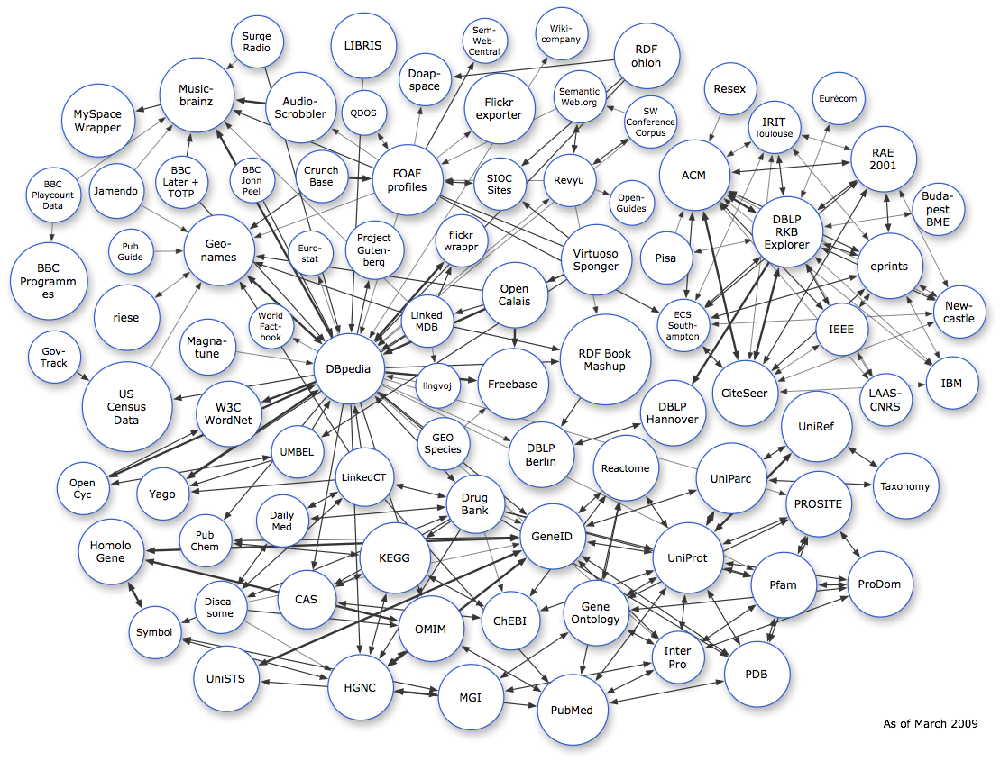
Managing metadata over data cubes
Data collection
Integration of major open data catalogs
UI for search and exploration of data sets
Rich metadata based on open standards
Both descriptive and structural metadata
Self-service UI
Custom queries and visualizations
Widgets, dashboarding, etc.
WORLD BANK

Slide 11
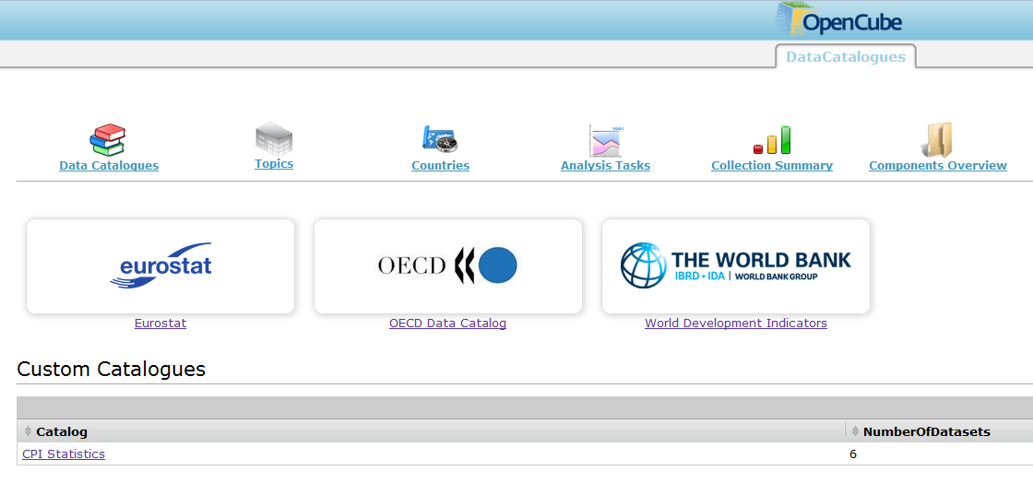
Data catalogue management
Managing catalogues of datasets
Search & discovery of relevant data
Goal: on-demand provisioning

Slide 12
OpenCube browser
It enables the exploration of an RDF data cube by presenting a two-dimensional slice of the cube as a table.
The slice is created by setting a fixed values for each dimension that is not presented in the table.
The browser is integrated in both IWB and PublishMyData platform.

Slide 13
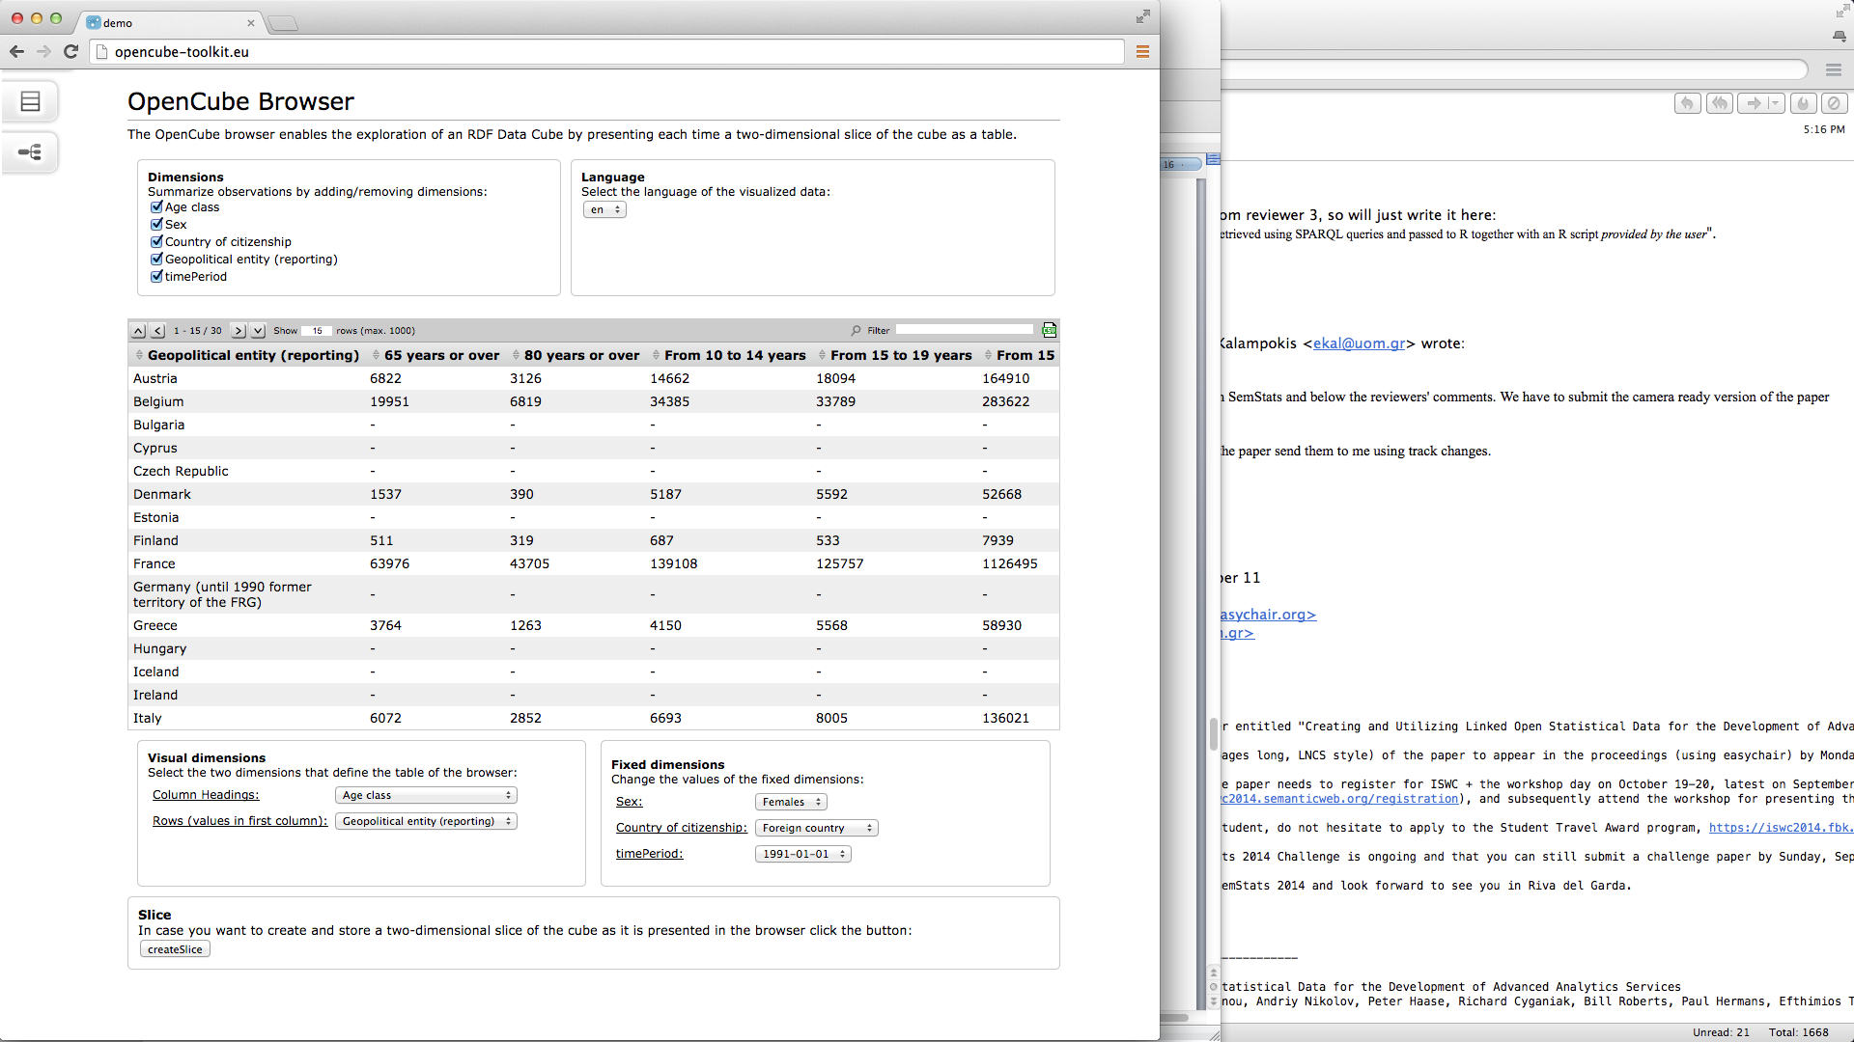
OpenCube browser (IWB extension)
Change the language
Summarize observations across a dimension (dimension reduction)
Change the fixed values
Change the axes of the table

Slide 14
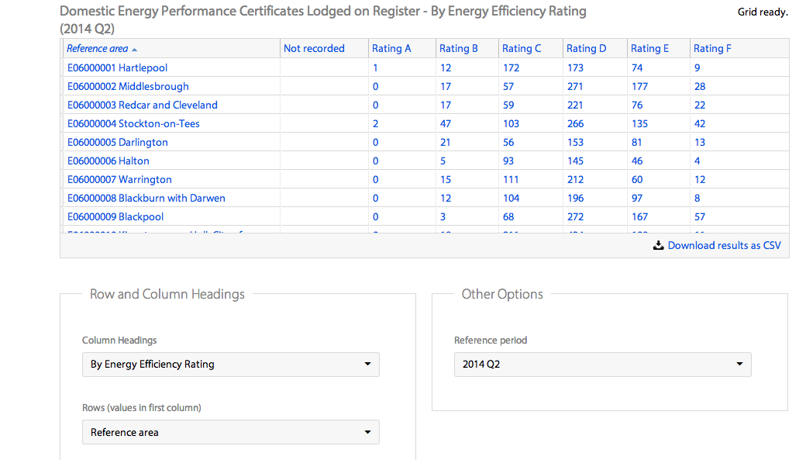
Data cube grid view (PublishMyData extension)
See http://opendatacommunities.org for live examples

Slide 15
Data cube grid view
Shows two dimensional slice of data
Controls to set values of other dimensions
Download chosen slice as CSV
Performs well with large datasets by loading data asynchronously as users scrolls through
See http://opendatacommunities.org for live examples

Slide 16
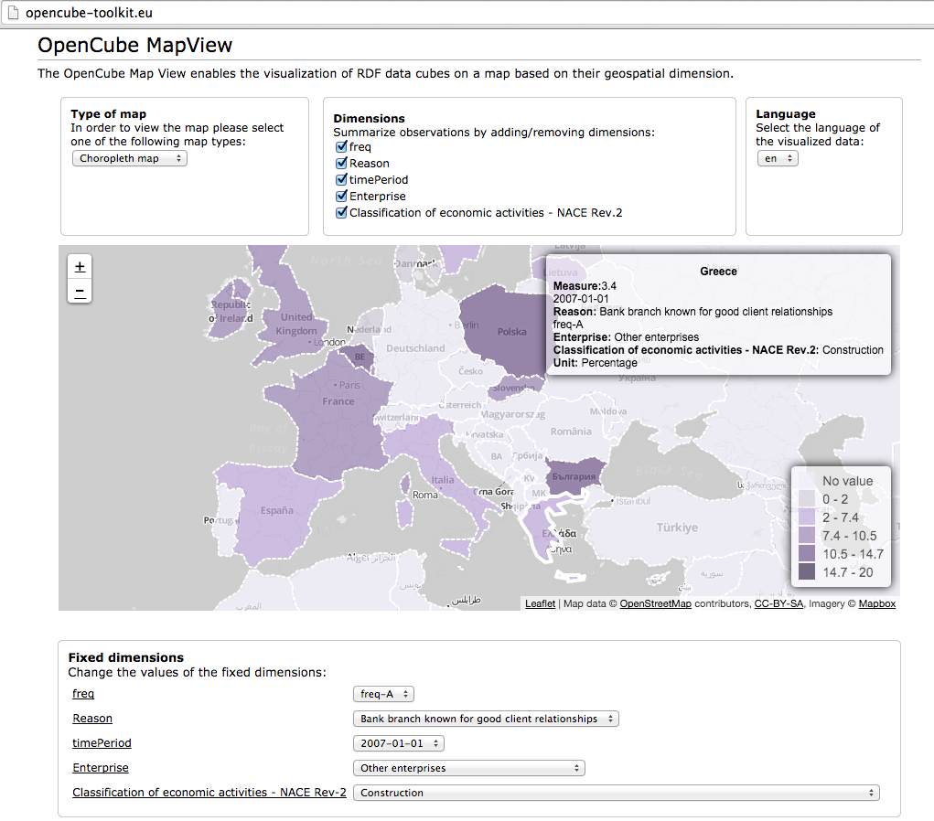
OpenCube MapView
It enables the visualization of RDF data cubes on a map based on their geospatial dimension.
It supports:
Markers
Bubble
Choropleth maps (need for polygons)
It is integrated in both
IWB and
PublishMyData

Slide 17
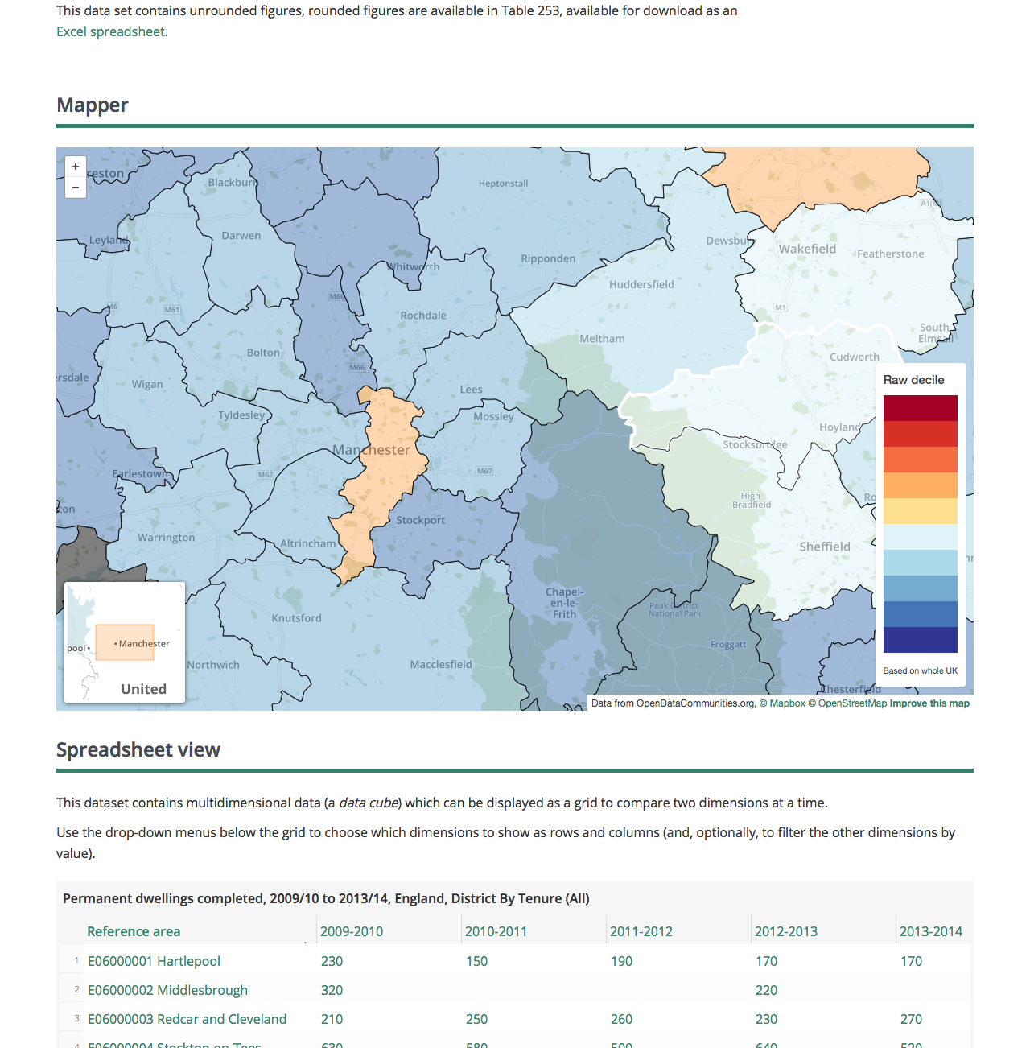
Choropleth map in PublishMyData

Slide 18
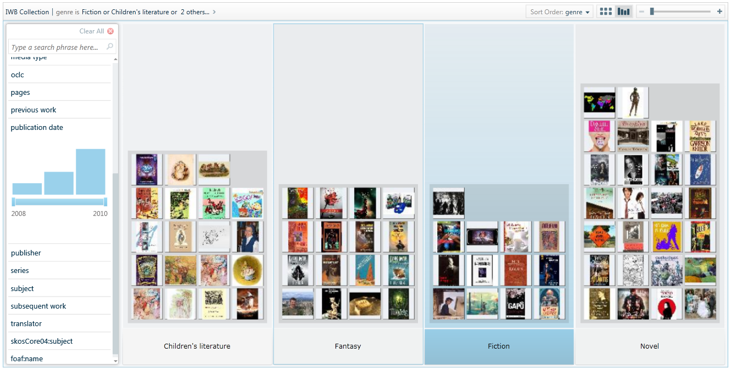
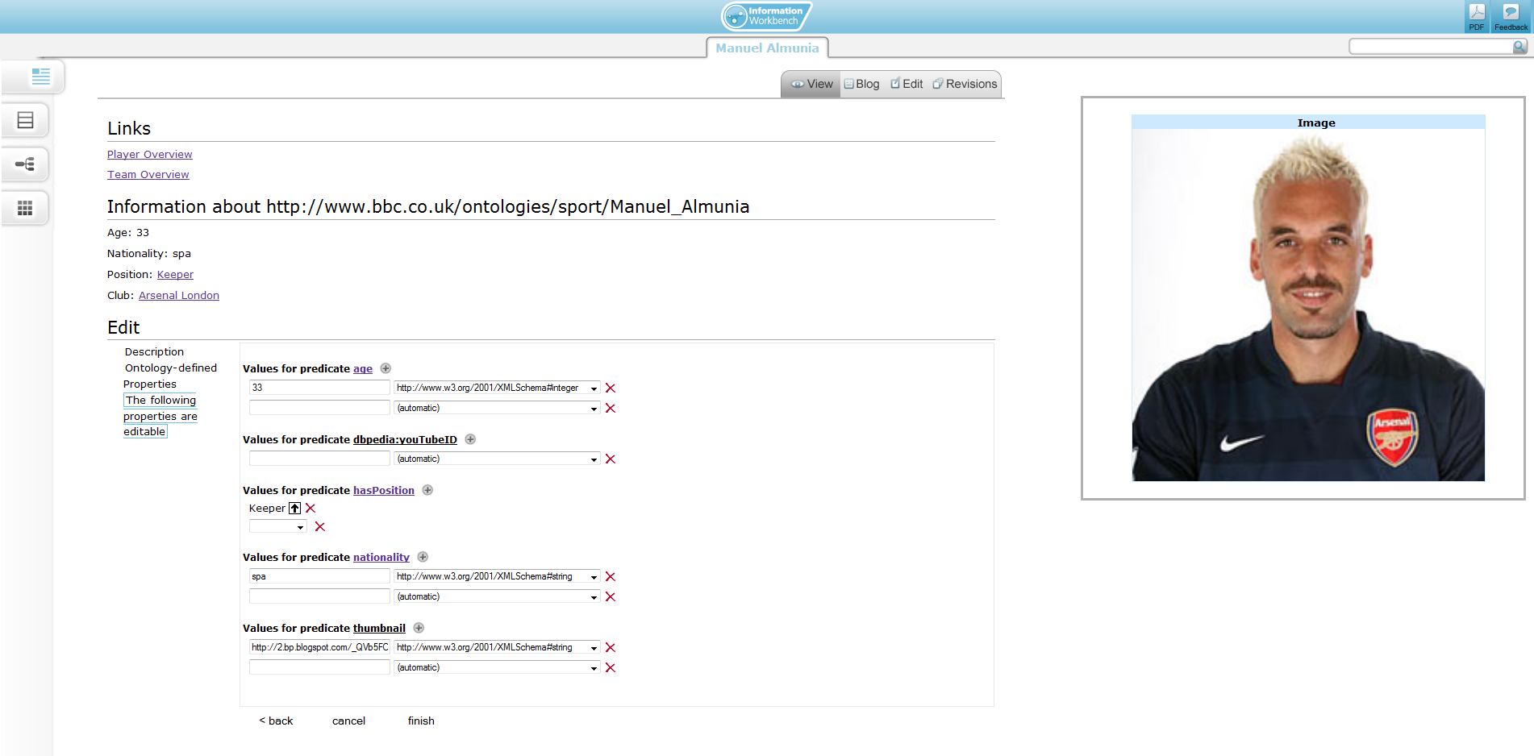
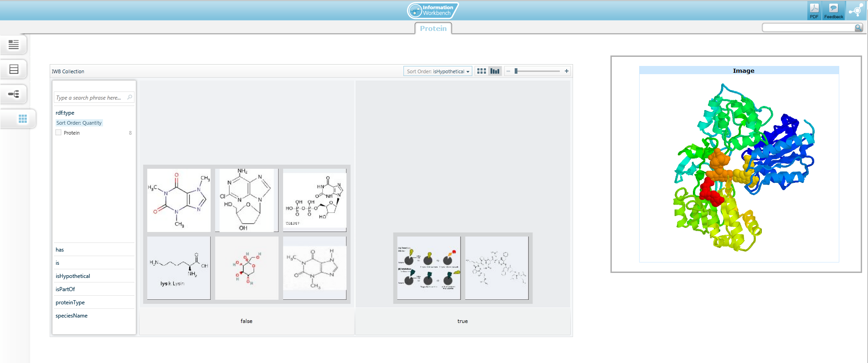


Support for advanced analytic tasks
Reuse of existing established tools to support advanced analytic tasks
Loose coupling integration with R
R is accessed as a web service
Rich analysis capabilities (all packages developed by the R community)

Slide 19
Integration with R
Visualisation of analysis results (charts & tables)
Reuse of analysis results: preserving R output as linked data
Managing a catalogue of the analytics experiments („recipes“)

Slide 20
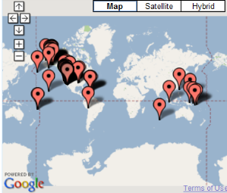
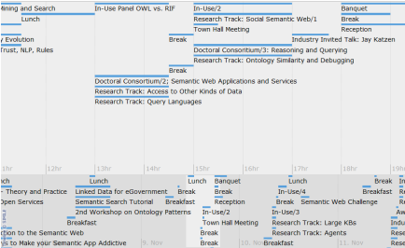
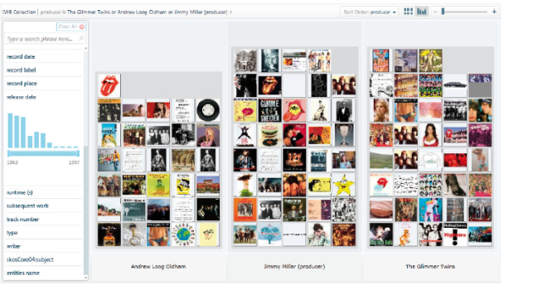
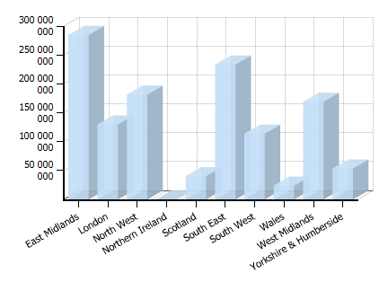
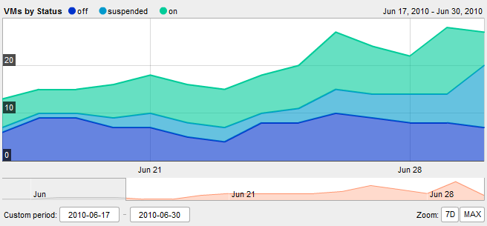
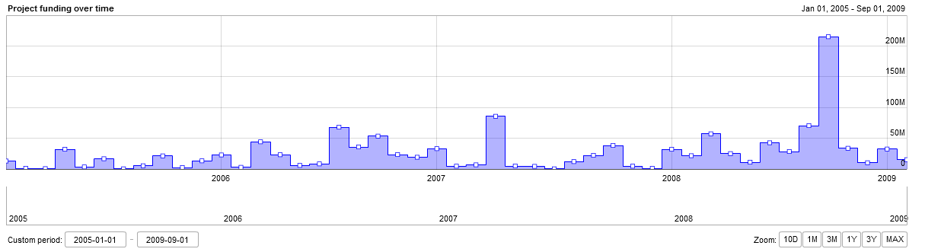
Data Cube Visualization
Visualization and Exploration
Widget-based visualization of data
Pre-existing: Configuration using explicit SPARQL queries
More appropriate for engineers building custom solutions than for end users
Goal: Intuitive configuration of visualization views exploiting the Data Cube structure
Analytics and Reporting

Slide 21
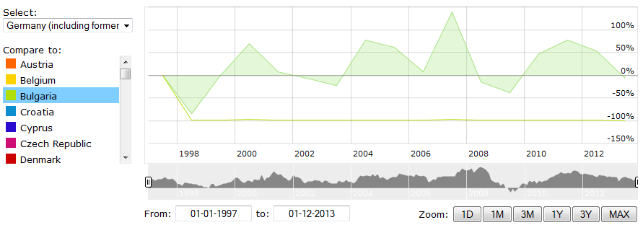
Stock chart visualization
Adaptation of the stock chart view to the RDF data cube datasets
Improved configuration UI
specifying dimension restrictions instead of the complete SPARQL query
Additional features (e.g., comparison between slices)

Slide 22
Initial Evaluation Results
We currently perform evaluations of the components in four pilots
Department for Communities and Local Government (UK)
Central Statistics Office (Ireland)
Flemish Government (Belgium)
Swiss Banks
Some interesting findings
Why to use linked data
Performance issues with large data sets
Noisy data

Slide 23
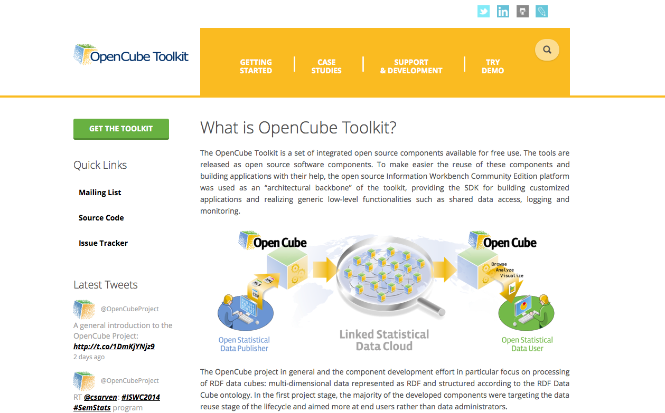
OpenCube toolkit
For more information
http://opencube-project.eu
http://opencube-toolkit.eu

